Slide 1

Introduction to Unifrog:
Parents Evening
I

Slide 2

What is Unifrog?
Unifrog believe that destinations - where students end up after school - is even more important than their academic performance. They partner with schools to support students to progress into the best opportunity for them.
Unifrog do this by providing a one-stop-shop where students can explore their interests, then find and successfully apply for their best next-step after school.

Slide 3
The Unifrog tools
Exploring pathways
Searching for
opportunities
Recording what you’ve done
Drafting application materials
Making applications
Careers library
UK universities
Activities
Personal Statement
Post 16/18 Intentions
Subjects library
US universities
Competencies
CV / Resumé
Locker
Know-how library
European universities
Interactions
Teacher References
Applications list
MOOC
Oxbridge
Common App Essay
Apprenticeships
College/ Sixth Form
Canadian universities
Asian universities
Special Opportunities

Slide 4
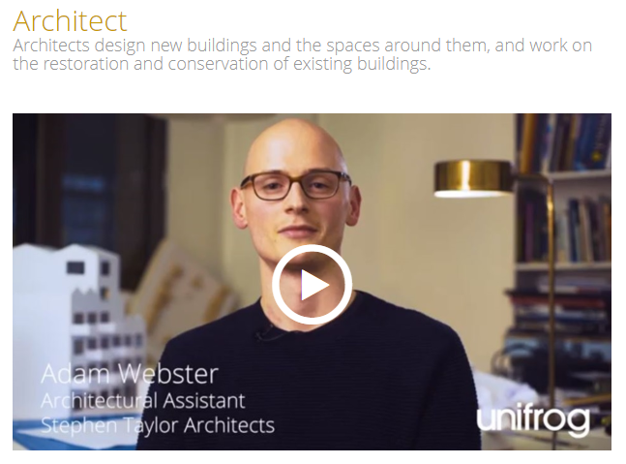
Careers Library
Over 1000 career profiles
Presents information from a range of sources
Includes qualifications and skills needed, interviews with industry professionals and labour market information
Explores progression opportunities and what a working week really looks like

Slide 5
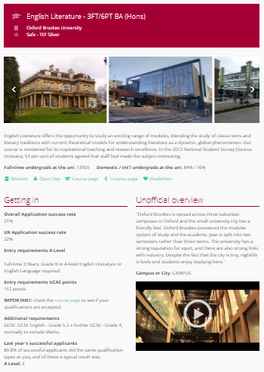
UK Universities
Students can enter subject of interest and projected grades to see all relevant university courses available in the UK
Rank and filter opportunities by factors like hours of lectures, price of accommodation and graduate job rates
Get direct links to university information pages, with impartial information on courses and institutions
Save unlimited shortlists to refer back to later

Slide 6
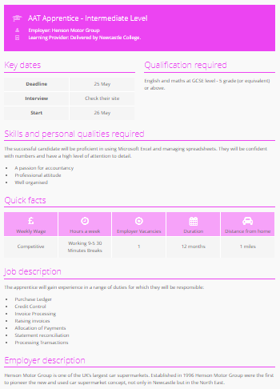
Apprenticeships
Students can find live apprenticeship vacancies
Vacancies are updated daily
Rank and filter opportunities by factors like distance from home, weekly wage and application deadlines
Direct link to the ‘apply’ page
Each apprenticeship vacancy includes practical information about the opportunity, employer and training
Save unlimited shortlists to refer back to later

Slide 7
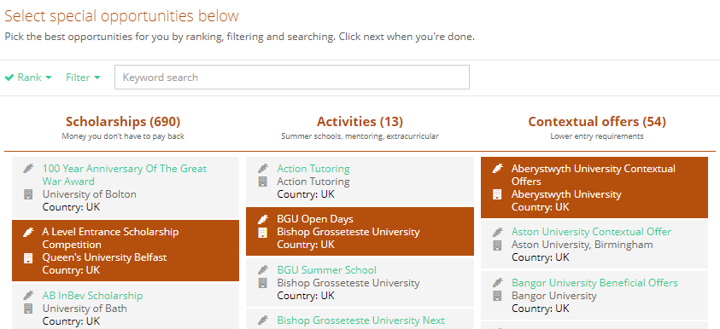
Special Opportunities
Includes £5 million-worth of grants, bursaries, scholarships, contextual offers and extracurricular activities
These can be filtered by circumstances or characteristics, depending on the access requirements of the opportunity
Includes direct links for applying
Unlimited shortlists can be created and referred back to

Slide 8
GDPR
GDPR is a regulation in EU law on data protection and privacy for everyone within the European Union and the European Economic Area.
Unifrog takes data security very seriously, and as such, has several features in place to protect school and student data.
We only use EU data centres, have multiple firewalls, layered-access security and more. Information on this can be found at unifrog.org/about#security
Notes:
Unifrog’s privacy policy can be found here: https://www.unifrog.org/privacy-policy
Service terms can be found here: https://www.unifrog.org/terms-of-service

Slide 9
Other cool stuff
The Unifrog platform contains so much more than what we can show you today, that was just four of their many tools.
So why not see for yourself? Sign up as a student and access the tools in exactly the same way that the students do.
You never know, there might be a new career just around the corner!

Slide 10
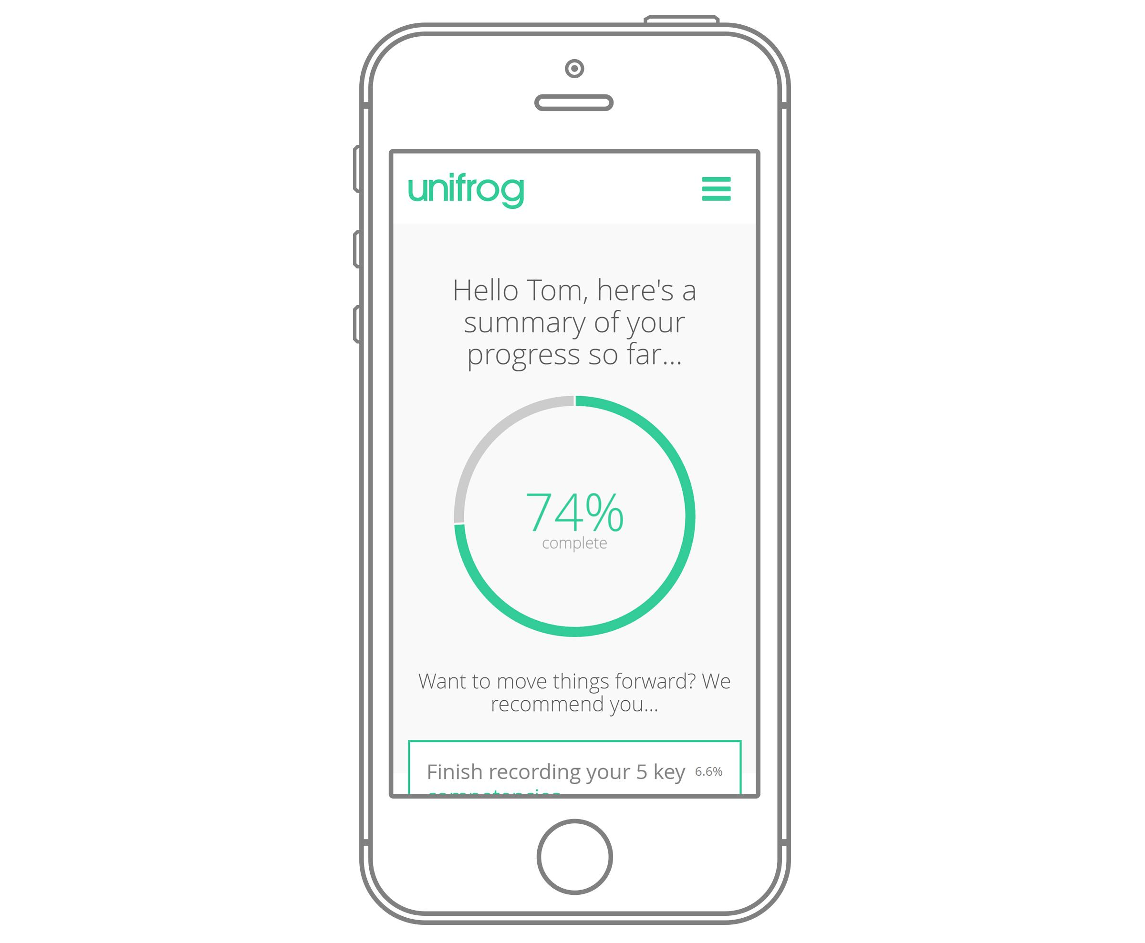
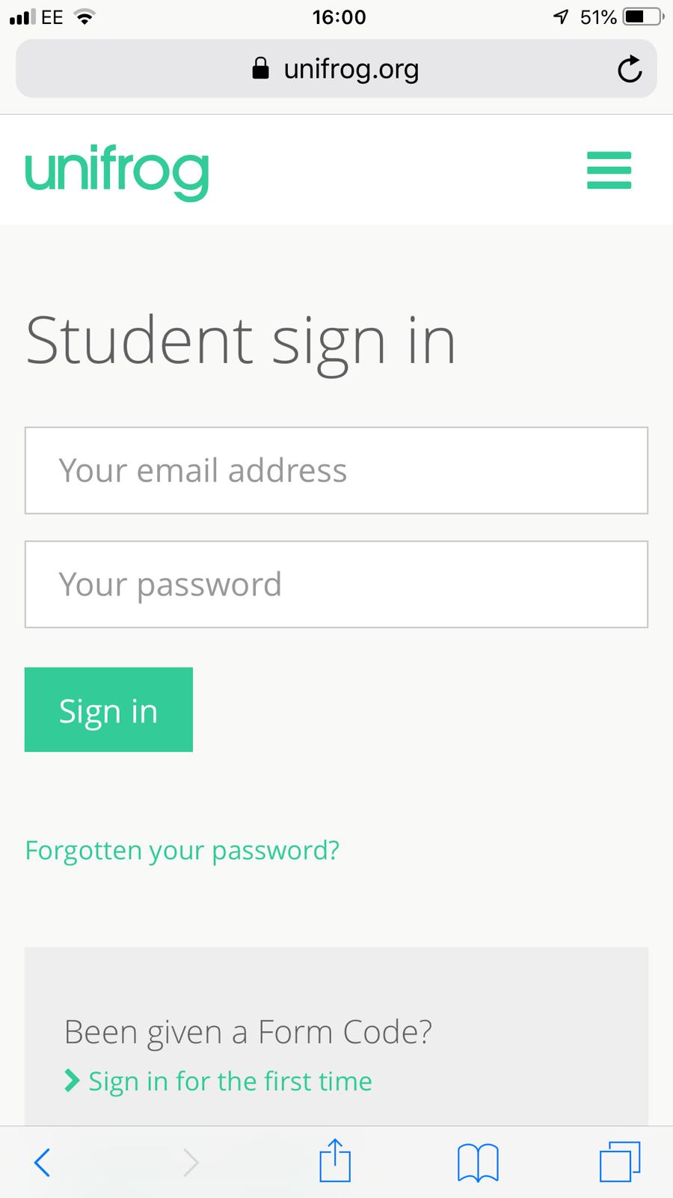
Parents & guardians, get signed up!
Go to www.unifrog.org/student and click ‘Sign in for the first time’
You’ll be asked for some details and a form code. This is what you need:
KTRNParents
After signing up, log into Unifrog using your email address and password via the student sign-in page!

